Slide 1


Top Discriminator Efficiencies and Signal Over Bkg for several selection Categories NTUA
Giannis Papakrivopoulos
George Bakas

Slide 2
Overview
Efficiencies vs mTTbarParton
Signal over Background for
Mtt samples over Bkg
Nominal sample over Bkg
Yields for all samples
All Signal over Bkg are vs mJJ
Categories:
1. Both jets are top tagged and b tagged
2. 1 Jet top and b tagged and other jet top tagged
3. 1 Jet top and b tagged and other jet b tagged
4. Both jets are top tagged
5. Both jets are b tagged
Cuts:
Reco:
nJets > 1,
|jetEta| < 2.4 (both jets)
jetPt > 400 GeV (both jets)
120 GeV < jetMassSoftDrop < 220 GeV (both jets)
Parton:
|etaParton| < 2.4 (both partons)
ptTopParton > 400 GeV (both partons)
mTTbarParton > 1000

Slide 3
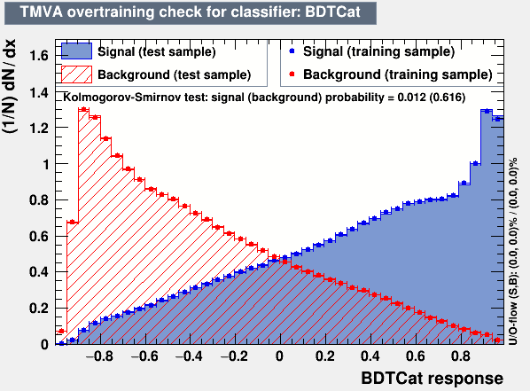
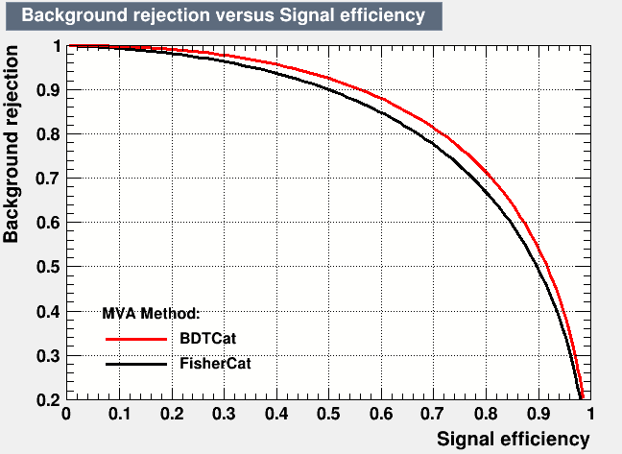
Training

Slide 4
Efficiency vs mTTbarParton
Top tagger cut : 0.6
B-tagging: Loose working point
nominal TT_TuneCUETP8M2T4_13TeV-powherg-pythia8
Mtt Samples

Slide 5
Efficiency vs mTTbarParton
Top tagger cut : 0.7
B-tagging: Loose working point
nominal TT_TuneCUETP8M2T4_13TeV-powherg-pythia8
Mtt Samples

Slide 6
Efficiency vs mTTbarParton
Top tagger cut : 0.8
B-tagging: Loose working point
nominal TT_TuneCUETP8M2T4_13TeV-powherg-pythia8
Mtt Samples

Slide 7
Efficiency vs mTTbarParton
Top tagger cut : 0.6
B-tagging: Medium working point
nominal TT_TuneCUETP8M2T4_13TeV-powherg-pythia8
Mtt Samples

Slide 8
Efficiency vs mTTbarParton
Top tagger cut : 0.7
B-tagging: Medium working point
nominal TT_TuneCUETP8M2T4_13TeV-powherg-pythia8
Over Bkg (All Categories)
Mtt Samples

Slide 9
Efficiency vs mTTbarParton
Top tagger cut : 0.8
B-tagging: Medium working point
nominal TT_TuneCUETP8M2T4_13TeV-powherg-pythia8
Mtt Samples

Slide 10
Signal over Bkg for mJJ (reco)
Top tagger cut : 0.6
B-tagging: Loose working point
nominal TT_TuneCUETP8M2T4_13TeV-powherg-pythia8
Over Bkg (All Categories)
Mtt Samples

Slide 11
Signal over Bkg for mJJ (reco)
Top tagger cut : 0.7
B-tagging: Loose working point
nominal TT_TuneCUETP8M2T4_13TeV-powherg-pythia8
Over Bkg (All Categories)
Mtt Samples

Slide 12
Signal over Bkg for mJJ (reco)
Top tagger cut : 0.8
B-tagging: Loose working point
nominal TT_TuneCUETP8M2T4_13TeV-powherg-pythia8
Over Bkg (All Categories)
Mtt Samples

Slide 13
Signal over Bkg for mJJ (reco)
Top tagger cut : 0.6
B-tagging: Medium working point
nominal TT_TuneCUETP8M2T4_13TeV-powherg-pythia8
Over Bkg (All Categories)
Mtt Samples

Slide 14
Signal over Bkg for mJJ (reco)
Top tagger cut : 0.7
B-tagging: Medium working point
nominal TT_TuneCUETP8M2T4_13TeV-powherg-pythia8
Over Bkg (All Categories)
Mtt Samples

Slide 15
Signal over Bkg for mJJ (reco)
Top tagger cut : 0.8
B-tagging: Medium working point
nominal TT_TuneCUETP8M2T4_13TeV-powherg-pythia8
Over Bkg (All Categories)
Mtt Samples

Slide 16
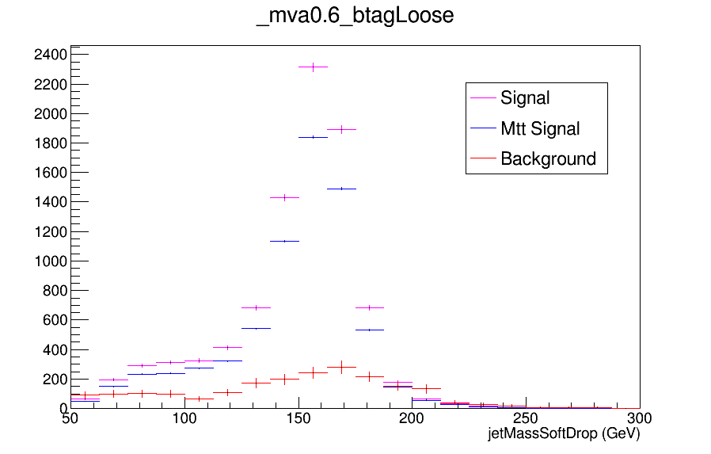
Expected Yields vs JetMassSoftDrop (double fill)

Slide 17
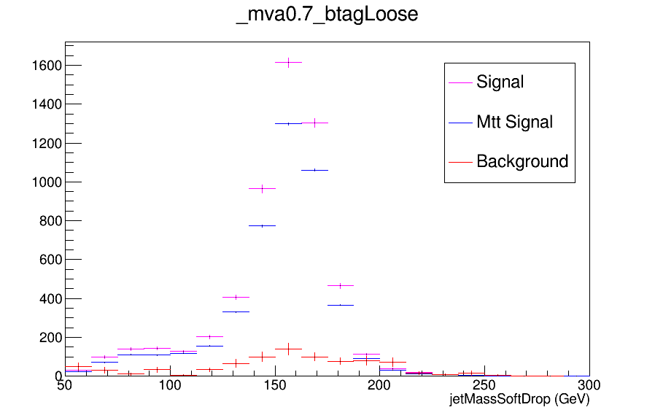
Expected Yields vs JetMassSoftDrop (double fill)

Slide 18

Expected Yields vs JetMassSoftDrop (double fill)

Slide 19
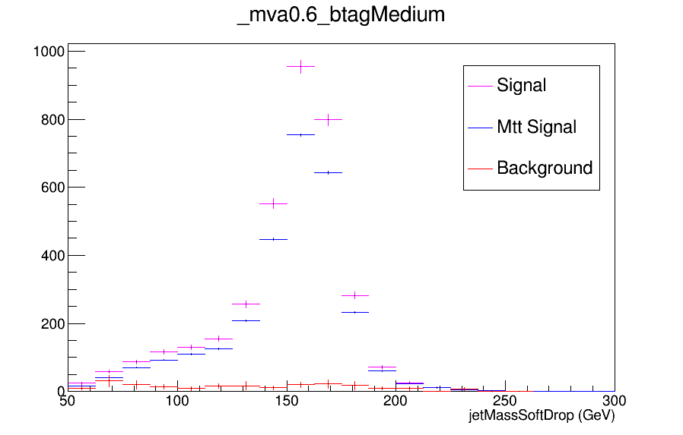
Expected Yields vs JetMassSoftDrop (double fill)

Slide 20

Expected Yields vs JetMassSoftDrop (double fill)

Slide 21
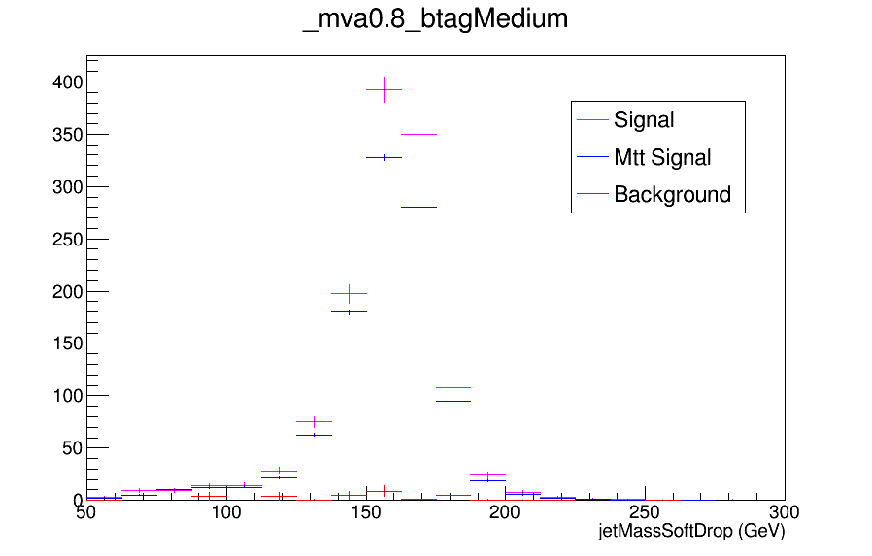
Expected Yields vs JetMassSoftDrop (double fill)

